Slide 1
RESTART

Slide 2
QUIT

Slide 3

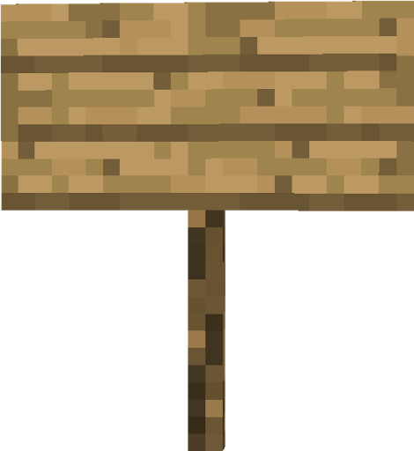

START
RESTART
EXIT
SAVE
LOAD
RESUME
QUIT
Emerald Forest ➔
PAUSED
EMERALD RUN

Slide 5
QUIT

Slide 6
START

